Slide 1
Entropy – score: a method to detect ddos attack and flash crowd
Akshat Guarav and Awadhesh Kumar Singh
Department of computer engineering, national institute of technology, Kurushatra Haryana, India
Akshat_guarav@yahoo.co.in aksingh@nitkkr.ac.in
Eyal Zvi Sean Etinger

Slide 2
overview
The internet plays a vital role in our day to day lives, therefore the demand for fast and reliable internet connections are increasing rapidly.
DDoS attacks are one of many threats that affect this growth, By flooding a victim with excessive malicious (fake) traffic DDoS attacks can cause a great deal of harm to a network, making the victim unable to serve real users.

Slide 3
The problem
Although there is a variety of different techniques designed to detect DDOS attacks, they all have their limitations, one of which is the inability to differentiate between Flash Crowd and DDOS attacks.
Flash crowd is an unexpected surge in visitors to a website, usually because of some newsworthy event.
Differentiating between DDoS and Flash Crowd is crucial do to the fact that filtering Flash Crowd can lead to loss of business or credibility.

Slide 4
The solution
The article we chose to implement proposes a new technique to detect DDOS attacks and differentiate them from Flash Crowd:
Entropy – Score
First, the packets are characterized using an entropy-based method.
Then, by using a score-based method the malicious packets are filtered and differentiated from the Flash Crowd ones.

Slide 5
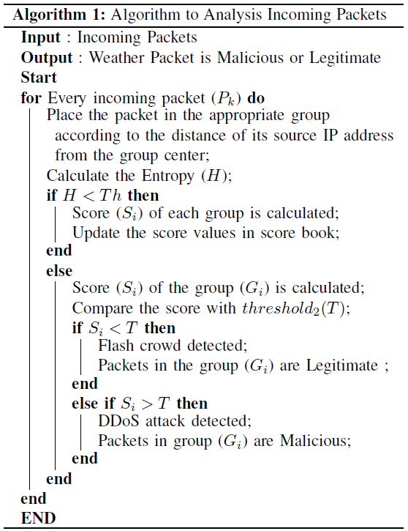
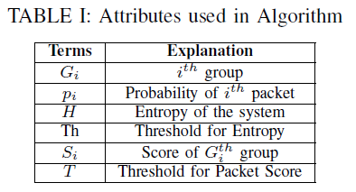


The algorithm

Slide 6
The algorithm - explanation
We place every incoming packet in the appropriate group by calculating the distance from each group center, the minimal distance is chosen but only if the distance is shorter than the predefined distance.
We then calculate the new system’s entropy and check if the threshold is overtaken.
If True, We update the scores of all groups.
Otherwise, we calculate only the score of the group we put the new packet in and then we check if threshold T was overtaken If so, the group is detected as malicious, else, it is detected as Flash Crowd.

Slide 7
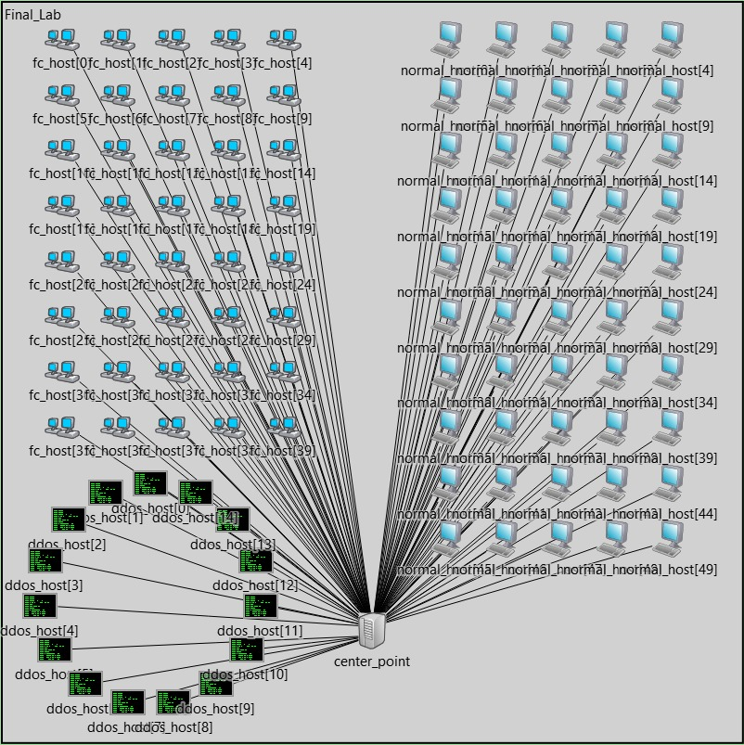
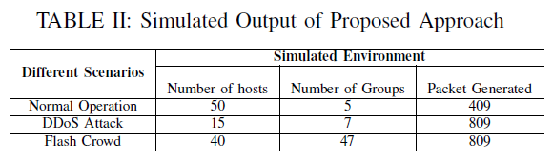
Our network
Our network contains four kinds of simple modules: Center Point – Represents a server receiving traffic. Normal Host – Represents a normal network client. DDoS Host – Represents a malicious network attacker. Flash Crowd Host – Represents a “rare” network client.
The characterization, filtering and statistical analysis is performed in the Center Point module.

Slide 8
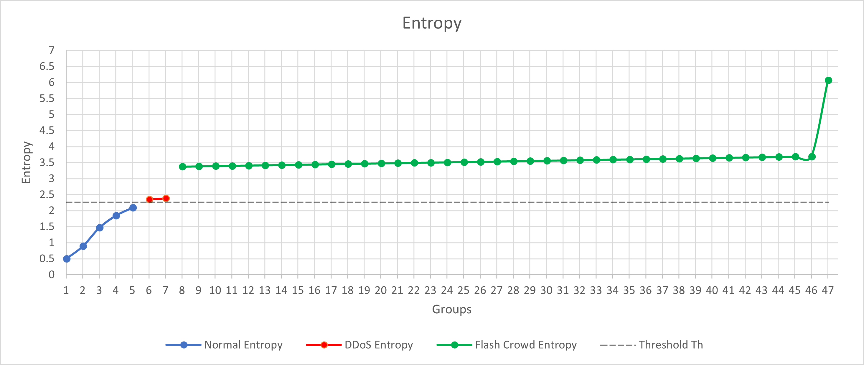

Results - Entropy

Slide 9
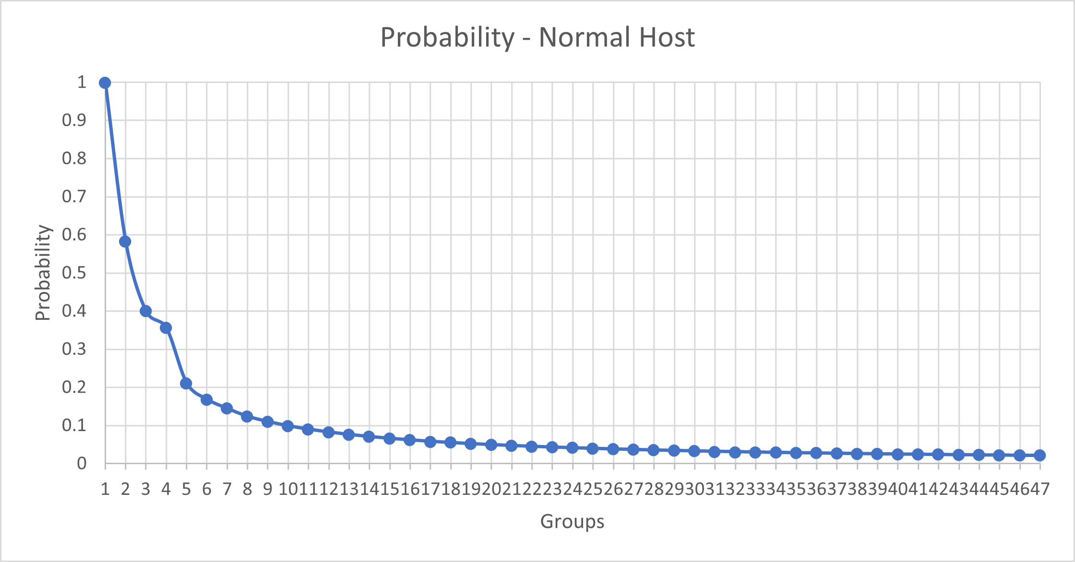
Results - Probability

Slide 10
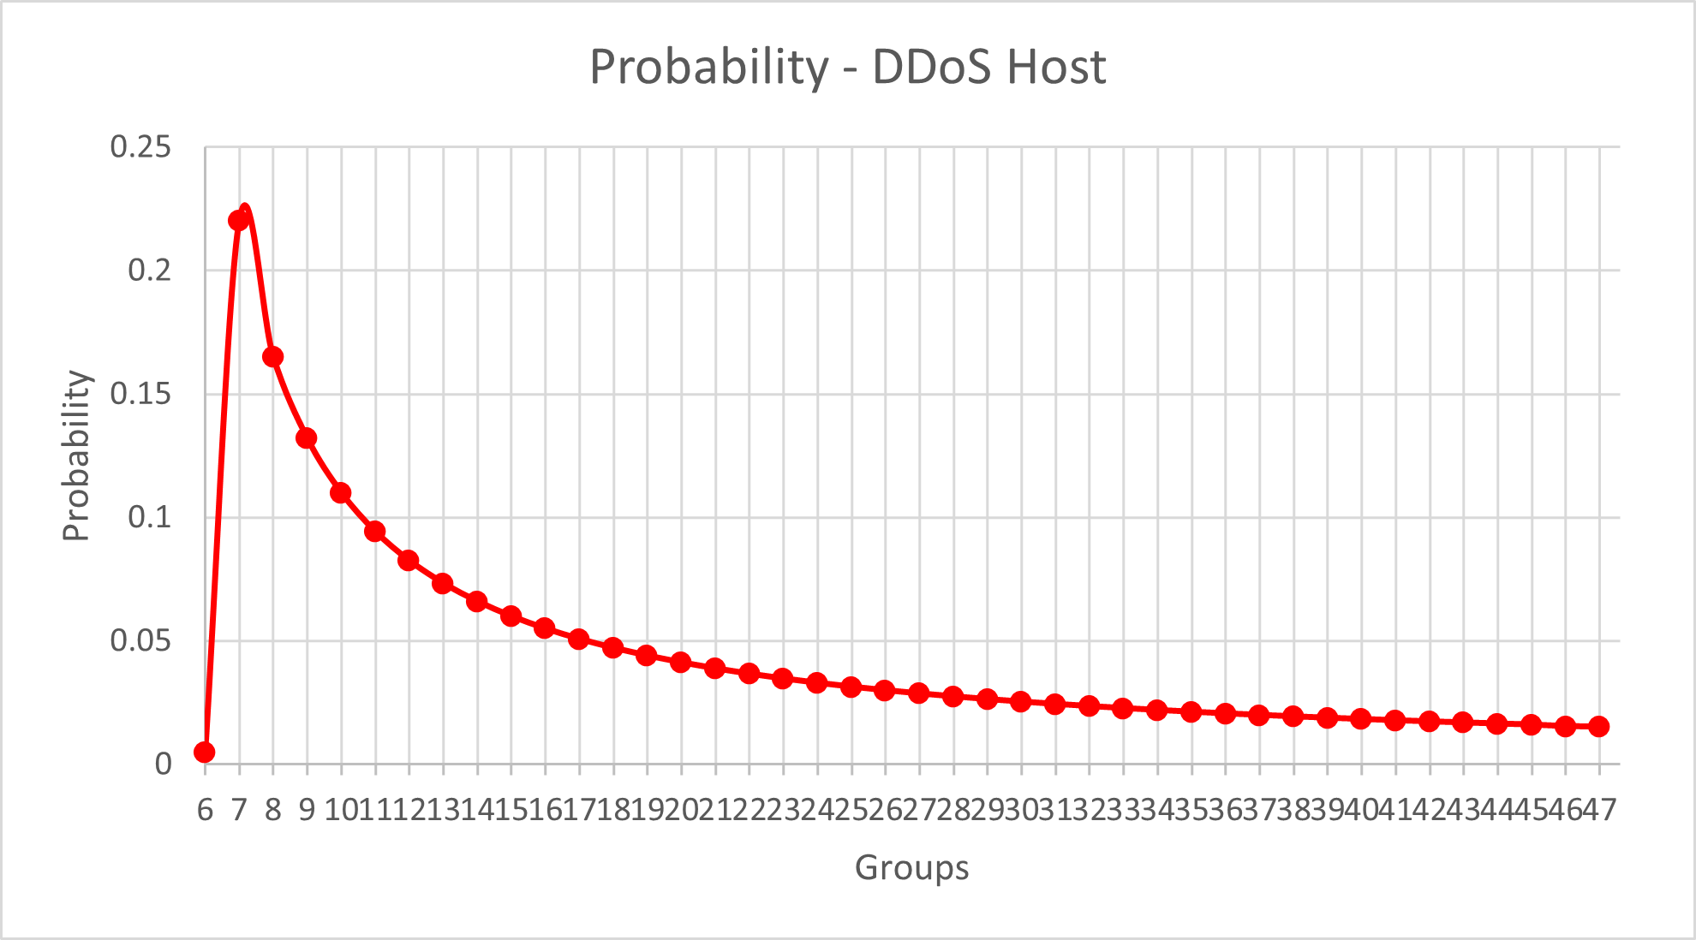
Results - Probability

Slide 11
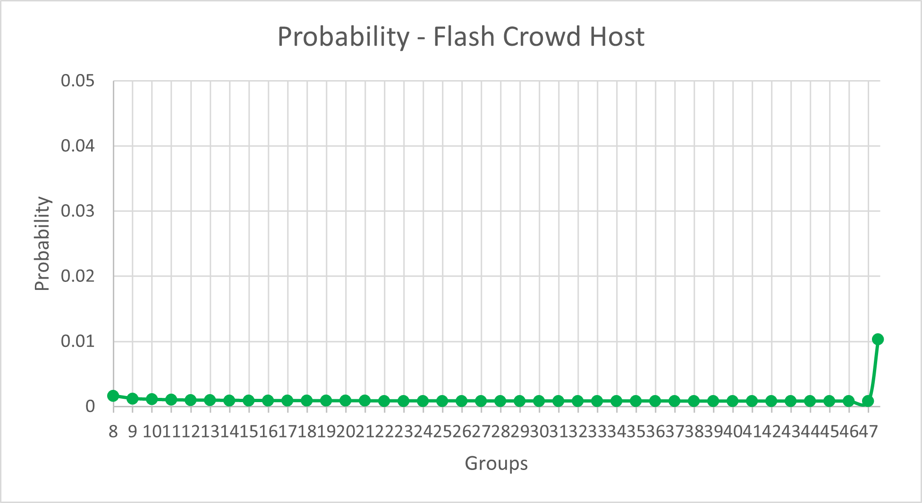
Results - Probability

Slide 12
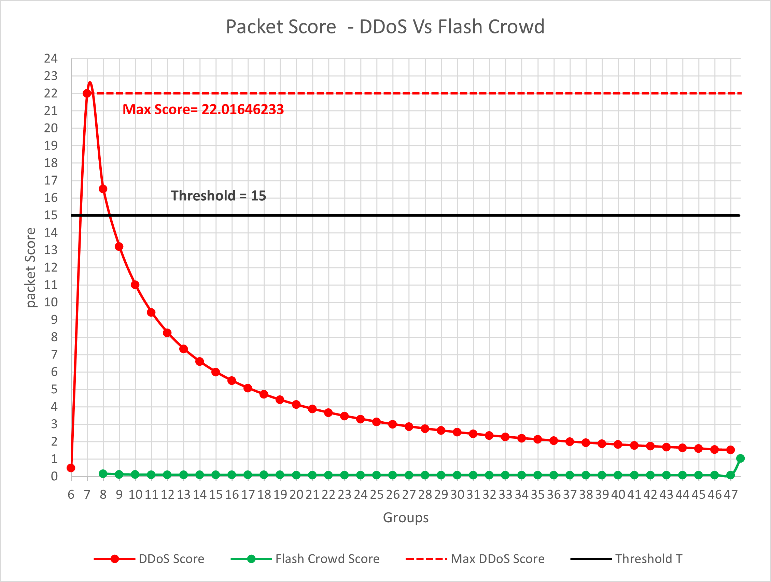
Results – Packet Score

Slide 13
Results – Efficiency analysis

Slide 14
Results – Efficiency analysis

Slide 15
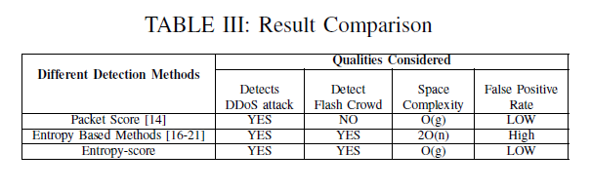
Conclusions
As we can see from our results of 89% decision correctness, we can very efficiently differentiate between DDOS attacks Flash Crowd, also, normal traffic is never mistaken for both.
As seen in our results, the algorithm has an extremely low False – Positive rate, 0% in our simulation.
This algorithm has a very good space complexity compared to other DDoS detection algorithms.

